Slide 1
Commas
Why are they important?

Slide 7
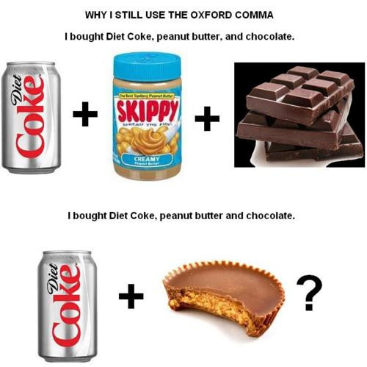

Slide 8
Hello, Nice to Meet You: Commas After Introductions
Use a comma in the following cases:
After an introductory clause.
After a long introductory prepositional phrase or more than one introductory prepositional phrase.
After introductory verbal phrases, some appositive phrases, or absolute phrases.
If there is a distinct pause.
To avoid confusion.

Slide 9
The pleasure is NOT mine: Comma Introductions Gone Bad
Do not use a comma in the following cases:
After a brief prepositional phrase. (Is it a single phrase of fewer than five words?)
After a restrictive (essential) appositive phrase. [More on that a little later]
To separate the subject from the predicate. [I’ll explain later]

Slide 10
Commas with introductory words
“Introductory words like however, still, furthermore, and meanwhile create continuity from one sentence to the next.”
“Hero” Example: The coaches reviewed the game strategy. Meanwhile, the athletes trained on the Nautilus equipment.
“Hero” Example: Most of the evidence seemed convincing. Still, the credibility of some witnesses was in question.
,
,

Slide 11
Common introductory phrases
prepositional phrases
appositive phrases
participial phrases
infinitive phrases
absolute phrases

Slide 12
Commas with introductory prepositional phrases
,
“Hero” Example: During the frigid Michigan winters, Shawn runs at the indoor track.
“Hero” Example: Of all the places she looked for her keys, Jenny did not think to look in the freezer next to the pizza rolls.
,

Slide 13
Your Turn!
Where do(es) the comma(s) go?
In the summer of 2006 I lived in Australia for six weeks.
In the event that tomorrow is a snow day you will turn your homework in the next day.
,
,

Slide 14
Commas with introductory participial phrases
,
“Hero” Example: Determined to run a mile in under 10 minutes, Shawn practiced every day to build up his endurance.
“Hero” Example: Persuaded by her brother, Jessica went rollerblading with her friends.
“Hero” Example: Entering Best Buy we were bombarded by four store employees on commission.
,
,

Slide 15
Your Turn!
Where do(es) the comma(s) go?
Undecided about running in the Boston Marathon Kelsey waited until the last day to sign up.
Recalled by her constituents the Mayor of Troy had to move out of her new corner office.
,
,

Slide 16
Commas with introductory clauses
RULE: Use a comma after an introductory adverb (subordinate) clauses
“Hero” Example: After the swim meet, Michael swam just a dozen more laps.
“Hero” Example: While walking to her next class, Katie listened to country music on her iPod Touch.
,
,

Slide 17
Introductory clauses
start with adverbs like…
After
Although
As
Because
Before
If
Since,
Though
Until
When
-ly
etc.

Slide 18
Your Turn!
Where do(es) the comma(s) go?
If you can dodge a wrench you can dodge a ball.
Calmly approaching the couple Julia asked them if they wanted to buy any Girl Scout Cookies.
,
,

Slide 19
Commas with compound sentences but NOT with compound sentence parts
RULE: Use commas before coordinating conjunctions only when the subject is mentioned or repeated in the clause containing the coordinating conjunction. If the subject is inferred, do not use a comma.
“Hero” Example: John went to the store, but Mary stayed home.
“Zero” Example: John went to the store, and bought bread
,
,

Slide 20
Review: Coordinating Conjunctions
For
And
Nor
But
Or
Yet
So
Did you notice that clauses on either sides of a coordinating conjunction were independent clauses?

Slide 21
Commas with compound sentences but NOT with compound sentence parts
RULE: Use commas before coordinating conjunctions only when the subject is mentioned or repeated in the clause containing the coordinating conjunction. If the subject is inferred, do not use a comma.
“Hero” Example: Jacob won Dancing with the Stars, yet Derek had a higher score.
“Zero” Example: Jacob won Dancing with the Stars, and received a $10,000 check.
,
,

Slide 22
Your Turn!
Where do(es) the comma(s) go?
Sam liked pepperoni pizza so he ordered one from Hungry Howie’s.
We have more errands to run but first I must quickly stop at my grandma’s house.
,
,

Slide 23
Your Turn!
Where do(es) the comma(s) go?
Peter robbed Paul for he need money.
Lisa never did her homework nor did she listen to her parents.
,
,

Slide 24
Let’s Debrief…

Slide 25
Exit Tickets!
Write a sentence that correctly uses a comma after an introductory clause.
Write a sentence that correctly uses a comma in a compound sentence withOUT compound parts.
(oops, I wrote it wrong ☹)

