Slide 1
Commas and their restrictive and non-restrictive friends at oxford
Restrictive & Non-restrictive clauses, oxford commas

Slide 2
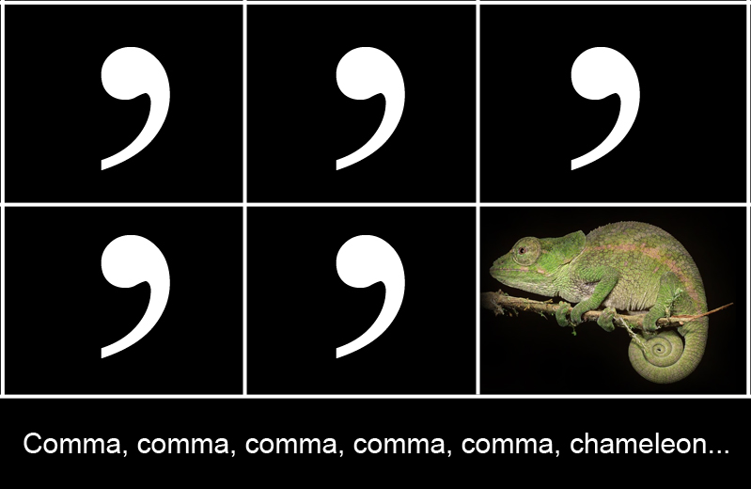

Slide 3
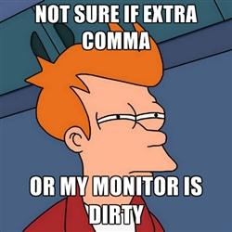
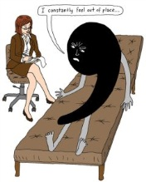
More Comma Humor…

Slide 4
Let’s Review…
Commas with Introductory Elements
Words
Meanwhile, the dog at two bowls of food
Prepositional Phrases
In the summer of 2006, I lived in Australia.
Participial Phrases
Walking into the mall, I saw a 20% off sign at The Gap.
Adverb Phrases
After the swim meet, Michael swam a dozen more laps.

Slide 5
Let’s Review
Commas with compound sentences but NOT with compound sentence parts
Comma before a coordinating conjunction
Subject must either repeat or another one stated
John went to the store, but Mary stayed home.
Jacob won Dancing with the Stars, yet Derek had a higher score.
Two independent clauses
Coordinating Conjunctions For, And, Nor, But, Or, Yet, So
(FANBOYS)
That is…the clause containing the coordinating conjunction would be an independent clause if you deleted the conjunction (but then you’d use a semi-colon)

Slide 6
Restrictive vs. Non-Restrictive (Relative) Clauses
Why does it matter?
Restrictive relative clauses are not set off by commas, while nonrestrictive relative clauses are.
So…can anyone explain the difference between the two?

Slide 7
Spiffy Definitions
When the relative clause limits or restricts the noun or pronoun it modifies, it is restrictive, and it is not set off by commas.
If a relative clause adds parenthetical, non-defining information, it is nonrestrictive. A nonrestrictive (parenthetical) element is set off by commas. [or you know…parenthesis…but too many parenthesis can be confusing, too]

Slide 8
“Let me see, let me see!”
Non-Restrictive
Mr. Smith, who is a well-respected lawyer, has just retired from active practice.
Professor James, who is an expert in Victorian poetry, will be giving a lecture tonight.
Restrictive
My brother that lives in Arizona is named Pat.
My daughter recently attended a Shakespearean play that was being performed at the rebuilt Globe Theater in London.

Slide 9
So What’s the Difference?
My brother that lives in Arizona is named Pat.
In this sentence the clause "that lives in Arizona" is needed to specify which brother, since the reader has no other way of knowing how many brothers the writer has or which brother is being referred to.
My other brother, who lives in Texas, is named Sam.
In this sentence the noun phrase "My other brother," conveys the information that the writer has only two brothers, and it also specifies which of those two brothers is being referred to, so the fact that he lives in Texas is extra information--not necessary for specifying which of two brothers is being referred to.

Slide 10
Oh, By the Way…
As a general rule, the pronoun "that" should be used for restrictive relative clauses, and "which" should be used for nonrestrictive relative clauses
If the clause is restrictive, choose "that" over "which" (about a 99% rule), and don't set the clause off with commas.
If the clause is nonrestrictive, choose "which" over "that" and do set the clause off with commas.
BUT…The relative pronoun "who" can be used in both restrictive and nonrestrictive relative clauses.

Slide 11
Did you know…
Usually, clauses or phrases that modify proper nouns are non-restrictive and take commas. Because specific names appear, you do not need the clause to phrase to identify the nouns.
Hillsborough Community College, which is located in Tampa, has four campuses.
Clauses or phrases beginning with the relative pronoun “that” are always restrictive; therefore, they never require commas.
The suit that he bought for the conference was very expensive.

Slide 12
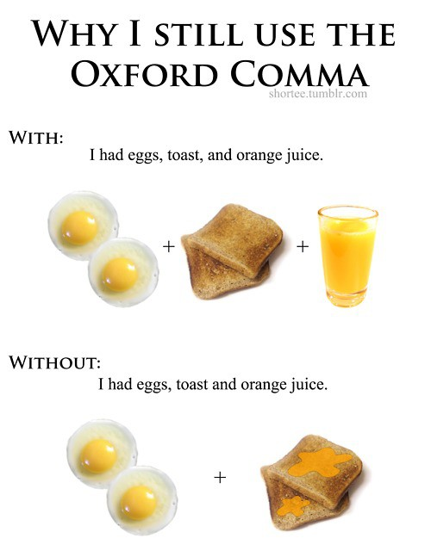
Oxford Commas
ALWAYS put the “oxford comma” in the list…unless you really mean to join the two words with the word “and”.

Slide 13
Types of Lists/Series
Nouns [You’re probably most familiar with this one.]
We served chicken, rice, and asparagus at the wedding.
Prepositional phrases
The defense attorney mailed the documents to her client, to the prosecutor, and to the judge.
Clauses
Parents usually care about what their teenagers do, where they go, and how much money they spend.
Notice…parallel structure

Slide 15
Let’s Practice
Worksheets are fun! Okay, maybe not. So, let’s do some sentences on the board together.
I’m going to call on people. Mrs. Martin has this cool app on her iPhone which simulates popsicle stick drawing. I think I’ll use it. ☺

Slide 16
Let’s Practice…Essential (restrictive) or non-essential (non-restrictive)?
Only people who like anchovies and garlic will enjoy this pizza.
Any car carrying more than two passengers is allowed in the express lane.
Uncle Ramón who is my mother’s brother just bought a bowling alley.
All people taking this course must be licensed veterinarians.
The poet whom I admire the most is Maya Angelou.
Natalie Curtis always interested in the music of Native Americans was an early recorder of their songs.
Margaret Mead who as a disciple of Ruth Benedict was a noted anthropologist.
The birds soaring overhead are hawks.
Parvis who is planning to play in the golf tournament is reading the NCAA rules.

Slide 17
Let’s Practice
I really want to make sure you have a good understanding of these comma rules because these are common mistakes in papers.
I have a worksheet for you.

Slide 18
Homework…Reminders/Suggestions
The signed portions from the syllabus and the book approval letter are due Monday. If you haven’t turned it in yet, you’ll need to do that.
English binder materials: bring them Monday. We’ll walk you through setting it up then.
Be on the lookout for an independent reading book you would like to read.
Finish the worksheets (or review them) if you did not finish in class.
I recommend you check out my Weebly site: http://msdavisedu.weebly.com or Mrs. Martin’s blog: http://martinsclass.wordpress.com . Pretty helpful…

