Slide 1
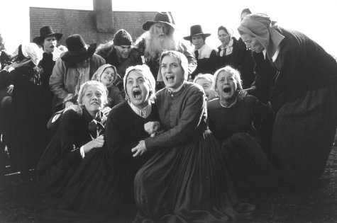
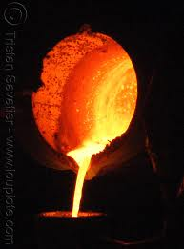
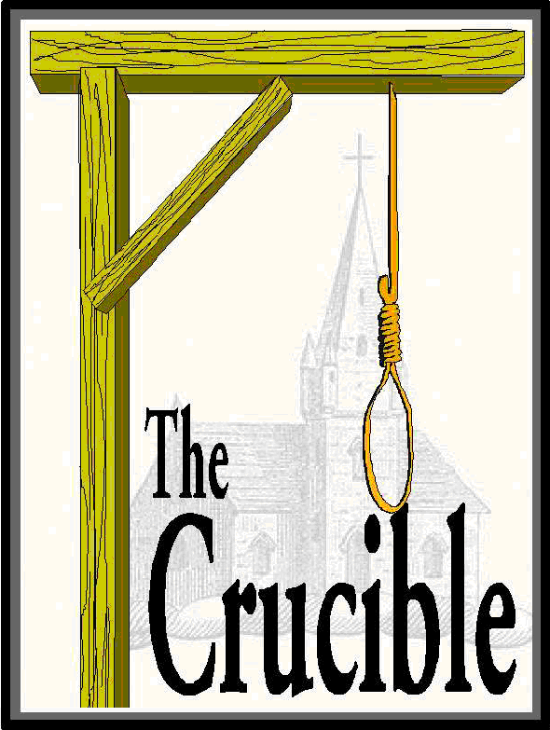
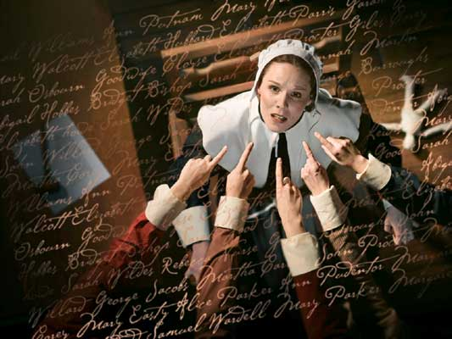
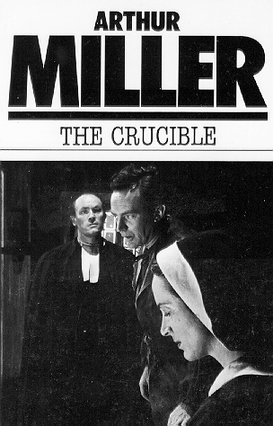
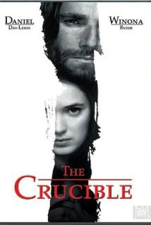

Slide 2
Arthur Miller
Born October 17, 1915, in Harlem, New York
Attended the University of Michigan
Wife: Marilyn Monroe
Sadly, it did not last – he was married a total of 3 times (Monroe was wife #2)
No More (Upper East Side) Manhattan, Hello Brooklyn
Family was wealthy, but nearly lost everything in the stock market crash in 1929.
Died: February 10, 2005 (89 years old)

Slide 3
Plays
All My Sons (1946)
Won a spiffy Tony Award for Best Author
Death of a Salesman (1949)
He wrote it in just one day!
Another spiffy Tony Award as well as a Pulitzer Prize and a New York Drama’s Circle Critic’s Award
The Crucible (1956)
Another spiffy Tony Award, this time for Best Play

Slide 4
Interestingly…
Miller’s Wife # 3 was an Austrian photographer, Inge Morath. They had two children, Rebecca and Daniel.
Unfortunately, Daniel had Down’s Syndrome and was ostracized by Miller for quite some time.
Oh, have you heard of an actor by the name of Daniel Day-Lewis? He played Lincoln in a recent movie…he also played John Proctor in the 1996 film.
PS: Daniel Day-Lewis was married to Rebecca. Yup, he’s the guy who played Lincoln is the son-in-law of the guy who wrote The Crucible. And he acted in his father-in-law’s play when it became a movie.

Slide 5
Speaking of the movie…
The movie stars Daniel Day-Lewis and Winoa Ryder.
It was released in 1996 and it is very close to the written play.
WOW! The screenplay is virtually the same as the play? How can this be? They cut so much from the Harry Potter books...
It’s because…Miller wrote the screenplay! He adapted his own play for the big screen.

Slide 6
Political Atmosphere of Salem in 1692
People feared what they did not know – and the Puritans took solace in religion. Religion gave them the structure and strength to survive in a harsh environment.
The Puritans did not understand the native cultures of the slaves they had (one slave mentioned in the play is from Barbados) so they did what many cultures did with the unknown – they condemned it and everyone who believed in it.
There was very little the Puritans could control – they could not control the weather, the Native Americans, spread of disease, etc. If they didn’t have an answer for it, it was deemed to be witchcraft and thus, punishable by death.

Slide 7
The Political Atmosphere of 1950s
McCarthyism was prominent
Sen. Joseph McCarthy was making threats of disloyalty in order to keep his own power
Fear of communism led to mass hysteria and eventually, fear by all.
Miller saw the political atmosphere was strikingly similar to that of the Salem Witch Trials. So, he wrote a play about the Salem Witch Trials that was really taking a stab at McCarthyism and the political atmosphere of the 1950s.
Shall we say, allegory?

Slide 8
Genre: Creative Non-Fiction
All the people in The Crucible really did exist. We will be researching them later this week.
Miller drew upon real life and real people for a work of fiction. The dialogue is fiction – Miller invented that. However, the trials, the hangings, the deaths, they are all very real.
We will be exploring the source material that Miller drew upon for his work of creative non-fiction (Technically, it is fiction because parts are fabricated. However, I want you to see and understand this “grey area” between fiction and non-fiction.

Slide 9
Food For Thought…
“Salem” is the last five letter of Jerusalem. Coincidence?
Why do the adult men (the court) believe these young girls over well-respected men?
Are the accused condemned before the trial even starts?
Why do we associate forests with the dark magic? Take Harry Potter, for instance, the forest around Hogwarts was full of dark magic. Bad things happened in fairy tales to those who went into the forest.

