Slide 1
Plagiarism
This is your “Come to Jesus Moment”

Slide 2
Random “Did you know that?”
The first “known use” of the word “plagiarism” was in 1621. (Courtesy of Merriam-Webster.com)
Coincidentally (or maybe not!) the first private newspaper was published in England…in 1621 (Jerry Norman’s From Cave Man Paintings to the Internet: Chronological and Thematic Studies on the History of Information and Media) http://www.historyofinformation.com

Slide 3
Some Definitions
“Dictionary” Merriam-Webster.com
“College” Grand Valley State
“1 : an act or instance of plagiarizing
“2 : something plagiarized
“— pla·gia·rist noun
“— pla·gia·ris·tic adjective”
“Any ideas or material taken from another source for either written or oral presentation must be fully acknowledged.”
http://www.gvsu.edu/academicintegrity/

Slide 4
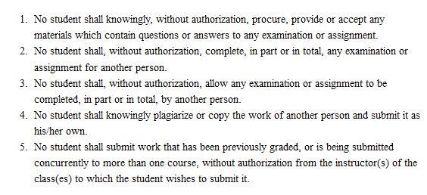
GVSU’s Integrity of Grades

Slide 5
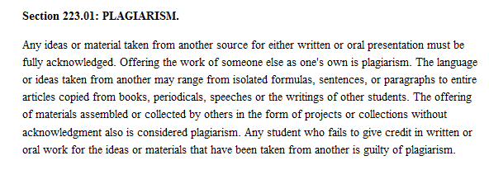
GVSU’s Full Definition of Plagiarism

Slide 6
Quotations
Word for word direct copying that is enclosed in quotation marks.
Make sure quotations are formatted correctly to avoid “invalid” quotations which then becomes plagiarism.
Cite the source directly before introducing the quote or directly after the closing quotation mark.

Slide 7
Paraphrasing
You CANNOT:
Exchange words for synonyms – still plagiarism (syntax)
Change order of phrases – essentially, the syntax is still the same (switching the order of two independent clauses or a dependent and independent does not avoid plagiarism)
You MUST:
Cite after paraphrasing (at the end of the sentence, not just at the end of the paragraph)
Rewrite in your own words

Slide 8
Summarizing
Similar to paraphrasing
Ensure the words and syntax are completely different, yet the essential meaning or the idea was not of your own creation, thus you must cite where you found the idea.

Slide 9
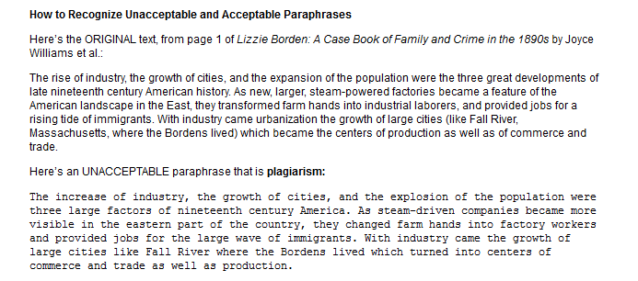
Examples (Indiana University) http://www.indiana.edu/~wts/pamphlets/plagiarism.shtml

Slide 10
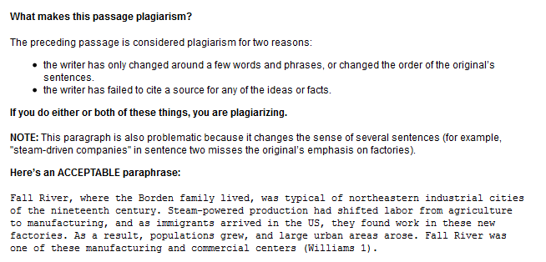
Examples (Indiana University) http://www.indiana.edu/~wts/pamphlets/plagiarism.shtml

Slide 11
Examples (Indiana University) http://www.indiana.edu/~wts/pamphlets/plagiarism.shtml

Slide 12
Notes:
Examples (Indiana University) http://www.indiana.edu/~wts/pamphlets/plagiarism.shtml

