Slide 1
Eats, Shoots and Leaves
Commas Save Lives

Slide 2
Story: Eats, Shoots and Leaves
A panda walks into a café. He orders a sandwich, eats it, then draws a gun and fires two shots in the air.
“Why?” asks the confused waiter, as the panda makes towards the exit. The panda produces a badly punctuated wildlife manual and tosses it over his shoulder.
“I’m a panda,” he says, at the door. “Look it up.”
The waiter turns to the relevant entry and, sure enough, finds an explanation.
“Panda. Large black-and-while bear-like mammal, native to China. Eats, shoots and leaves.”

Slide 3
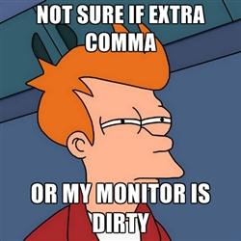
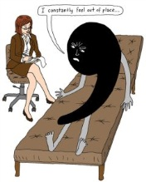
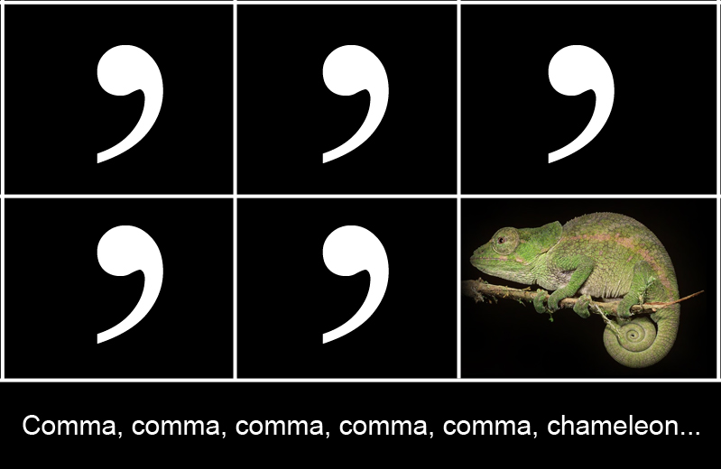
Let’s Vote…Favorite Joke

Slide 4
One Last Joke…
Why is a cat not a comma?
A cat has claws
at the ends of its paws.
A comma’s a pause
at the end of a clause.

Slide 5
Okay, Okay, All Joking Aside…
Commas are important.
Both the lack of commas and the overuse of commas leads to confusion.
Confusion leads to wrong interpretations
Wrong interpretations leads to fights and unhappiness.
Avoid unhappiness…use commas correctly.

Slide 6
Close Enough…?
Dear Jack, I want a man who knows what love is all about. You are generous, kind, thoughtful. People who are not like you admit to being useless and inferior. You have ruined me for other men. I yearn for you. I have no feelings whatsoever when we’re apart. I can be forever happy – will you let me be yours? Jill

Slide 7
Same words, so…same meaning?
Dear Jack, I want a man who knows what love is. All about you are generous, kind, thoughtful people, who are not like you. Admit to being useless and inferior. You have ruined me. For other men I yearn! For you I have no feelings whatsoever. When we’re apart I can be forever happy. Will you let me be? Yours, Jill

Slide 8
Let’s Review… When to Use Commas
After an introductory element
Around a non-restrictive (non-essential) phrase
In lists
Attributing quotations
Between two or more adjectives
With interrupters (appositives, interjections, etc.)

Slide 9
Let’s Review… When NOT to Use Commas
After a brief prepositional phrase (single phrase less than five words)
After a restrictive (essential) appositive phrase
To separate the subject from the predicate

Slide 10
It’s Game Time…
Save the Comma! http://www.savethecomma.com/game/
How shall we play? Mrs. Martin’s Popsicle Stick app, of course!
Chomp, Chomp! Grammar Bytes!
http://chompchomp.com/hotpotatoes/commas02.htm
Fill out the handout as we go along so you can study tonight.

Slide 11
Don’t Forget to Review Your…
Comma notes
Comma practice worksheets
Grammar notes
Mentor sentences

